Slide 1

mrge Data Analytics Task
Analyst: Abhishek Singh
Tech Stack: Python, Jupyter Notebook, SQL, Tableau, Microsoft Powerpoint, draw.io
Date: Jan-2026

Slide 2
Task 1
A Sales Data Source that supports a self-service reporting model, allowing end users to easily build ad-hoc reports.

Slide 3
Task 1: Solution
• Tableau Data Source (.tdsx) created following Tableau data source best practices to support self-service reporting.
• In a production environment, the preferred approach would be to use a database view or materialized view as the Tableau connection.
• For this proof of concept, the data source was created using an Excel extract generated via data transformations performed in Python.

Slide 4
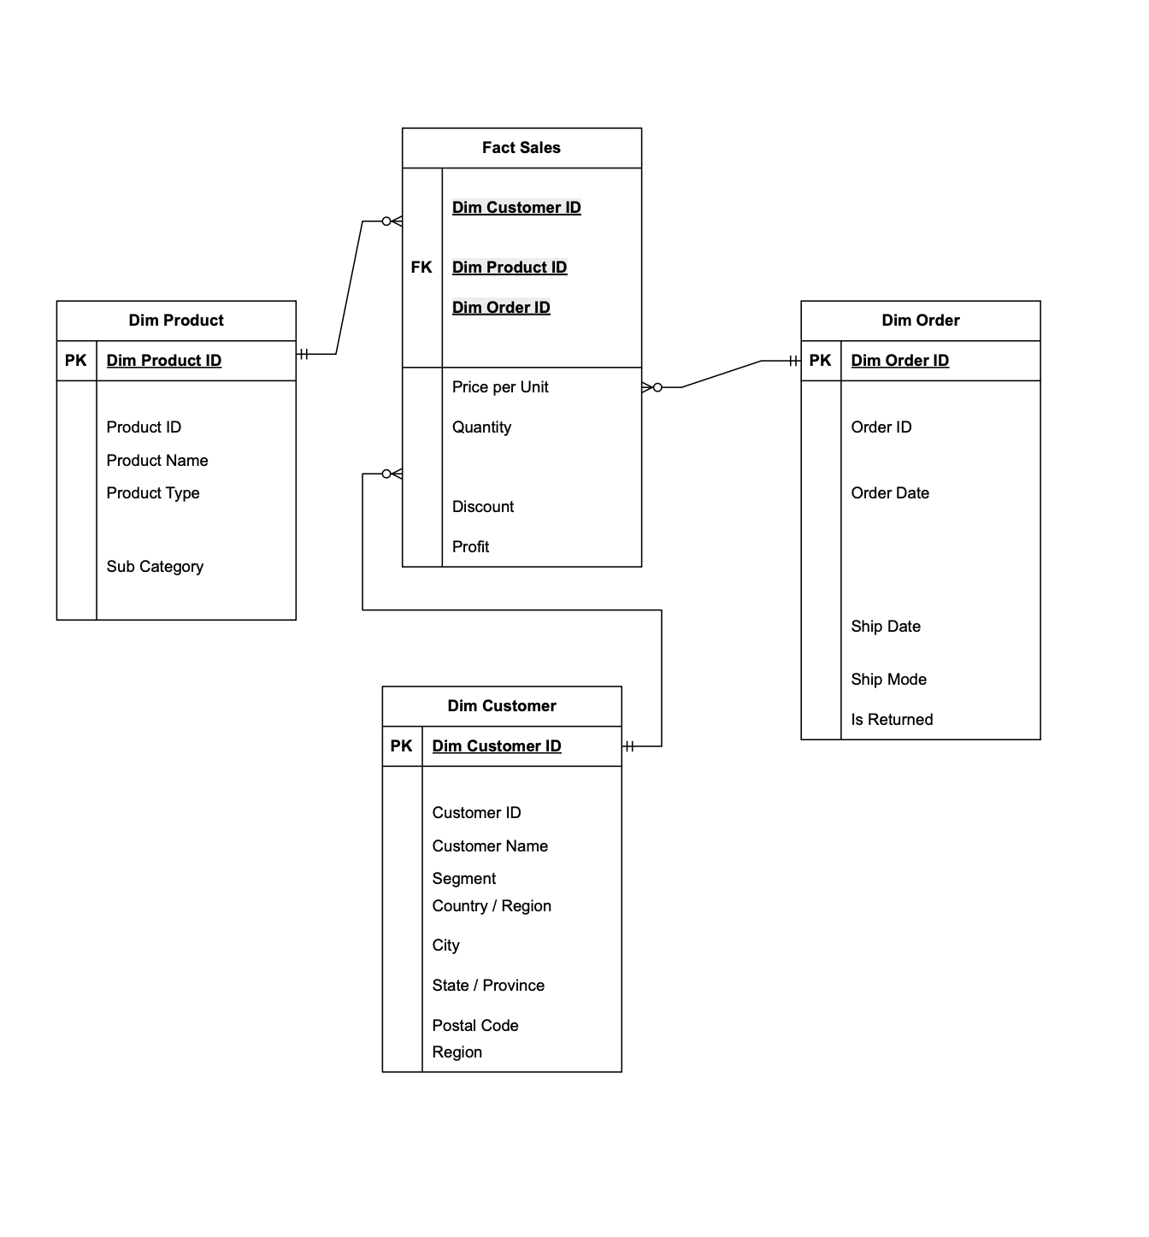
Task 1: Solution
Based on the sample data, a star schema was the most appropriate design, with dimension tables connected to the fact table through foreign keys. Created using draw.io!

Slide 5
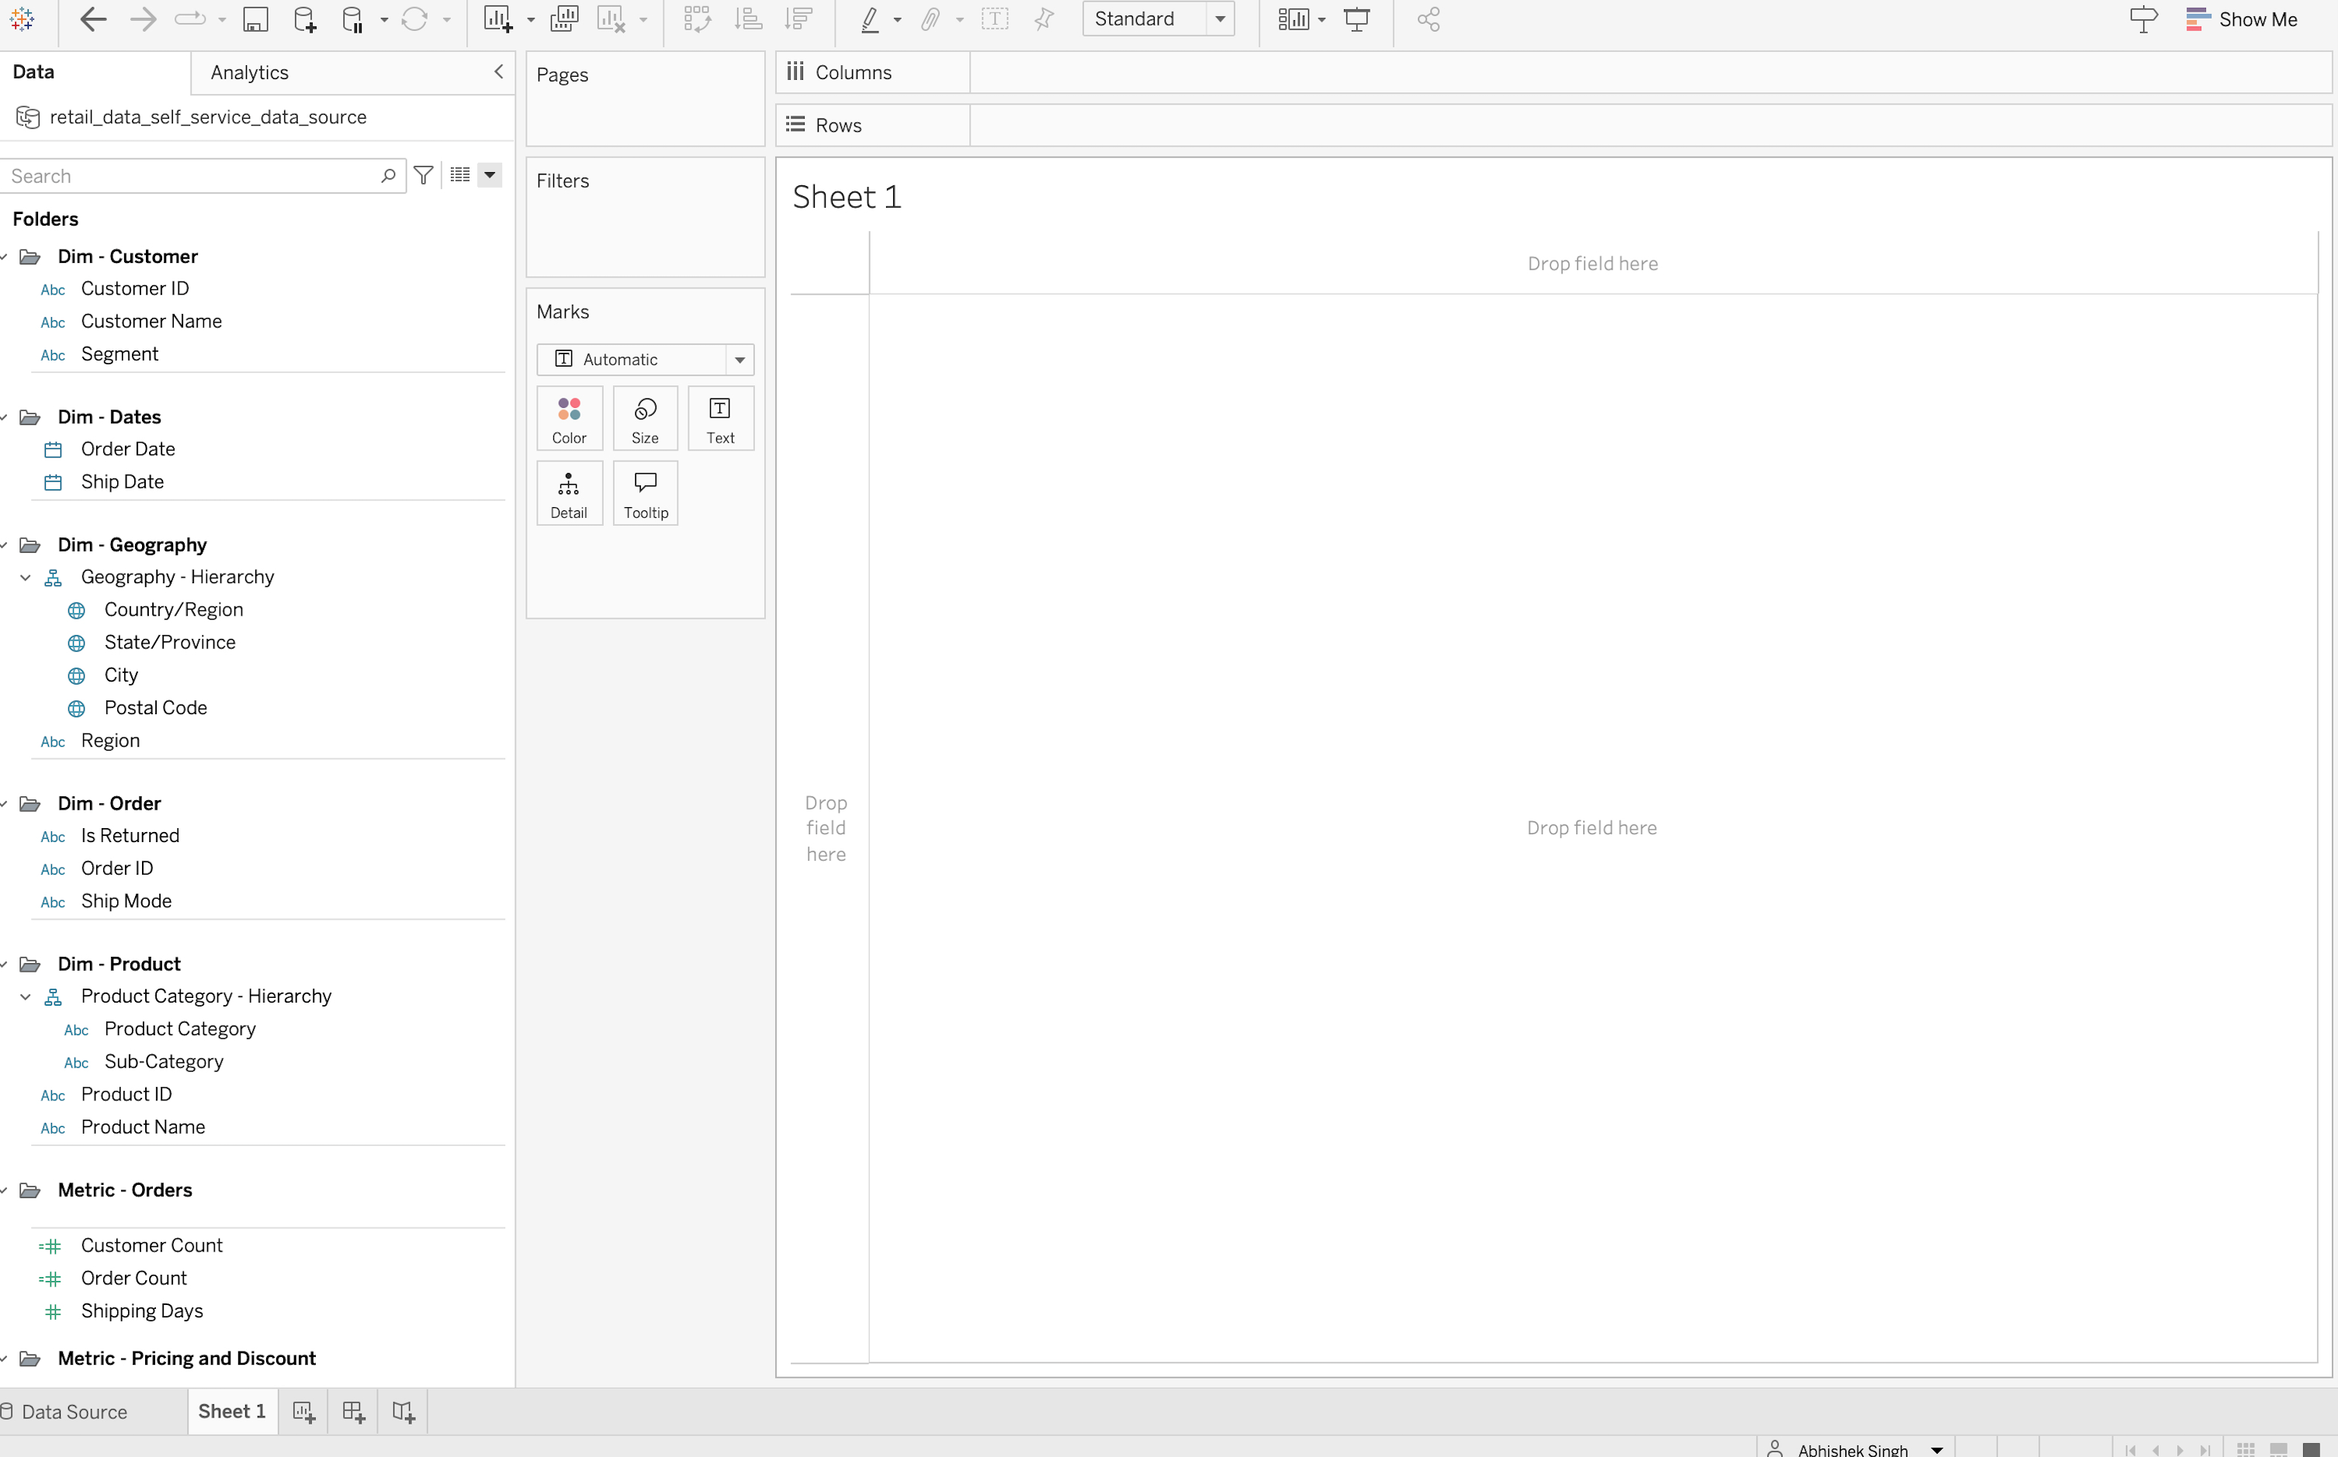
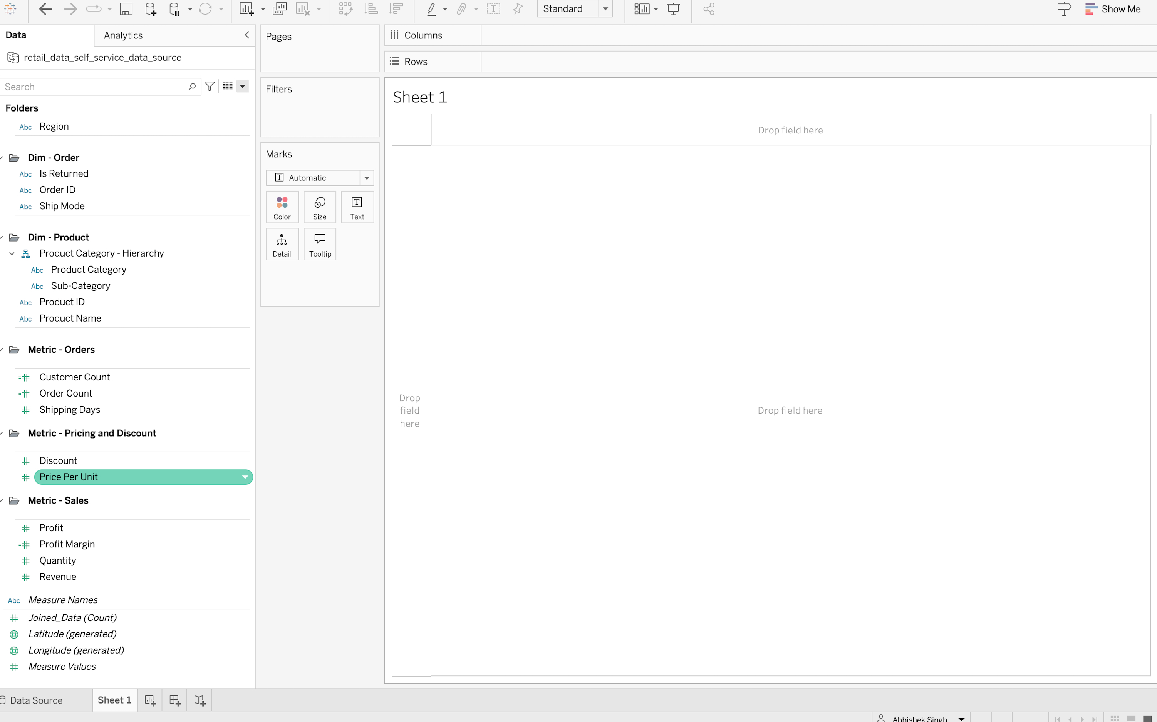
Task 1: Solution
Screenshots of solution

Slide 6
Task 2
A Global Sales Dashboard for executive stakeholders to quickly monitor overall
sales performance.

Slide 7
Task 2: Solution
• Tableau Retail Dashboard (.twbx) created using published Tableau data source created in Task 1.
• Dashboard connected to published data source is easy to maintain and refresh. A change in data source updates all connected dashboards automatically!
• Interactivity is inbuilt in dashboard in forms of filters and sliders that provide “What if Analysis”. A filter for returns helps separating returned and non returned order for a more targeted analysis!

Slide 8
METRIC DEFINITIONS
Revenue
Total sales value generated from orders after discounts are applied.
Calculated as: Price Per Unit × Quantity × (1 − Discount)
Profit
The financial gain from sales after costs are accounted for.
Provided directly from the source data.
Profit Margin
The percentage of revenue that is retained as profit.
Calculated as: Profit ÷ Revenue.
A higher margin indicates more profitable sales.
Discount
The percentage reduction applied to the product’s price.
Example: A discount of 0.20 represents a 20% discount.
Shipping Days
The number of days taken to ship an order from the order date to the ship date.
Calculated as: Ship Date − Order Date.
Order Count
The total number of unique customer orders.
Based on distinct Order ID values.
Returned / Not Returned
Indicates whether an order was returned by the customer.
Returned – The order was returned.
Not Returned – The order was successfully completed.
Customer Segment
A classification of customers based on business-defined segments.
Product Category / Sub-Category
Product grouping used to organize items into broader categories for analysis.
Shipping Mode
The method used to ship the order (e.g., Standard, Second Class, Same Day).
Task 2: Solution

Slide 9
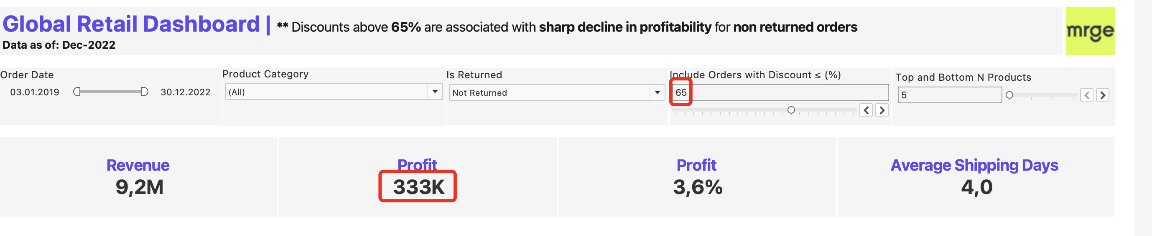
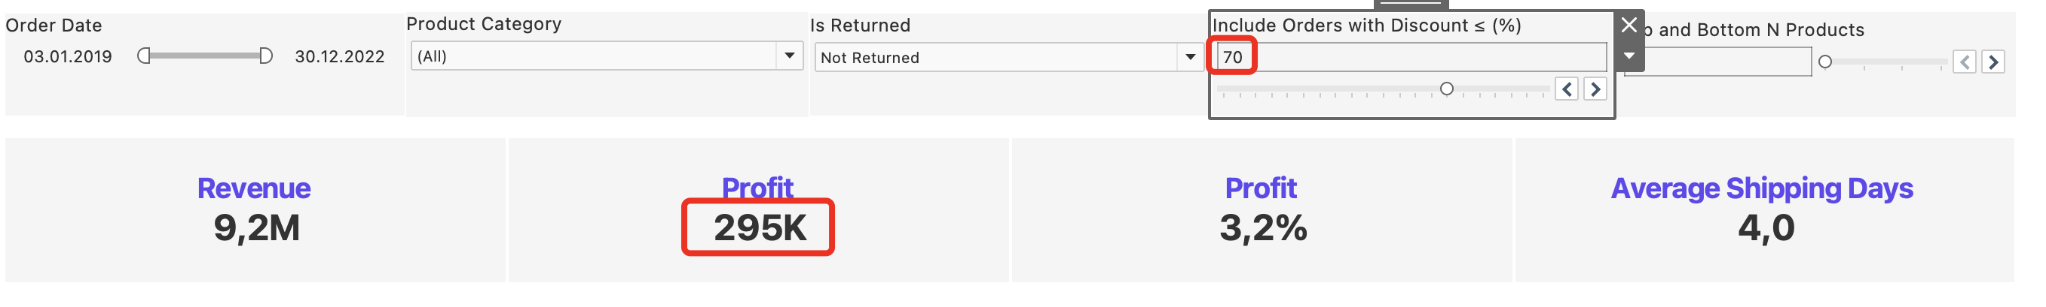
Task 2: Solution
DISCOUNT SCENARIO FILTER
The “Include Orders with Discount ≤ (%)” slider allows users to explore how sales performance changes when higher-discounted orders are excluded from the analysis.
Selecting a lower percentage filters the dashboard to include only orders with discounts less than or equal to the selected value.
Setting the slider to 100% includes all orders and removes the discount-based filter.
This control enables scenario analysis to understand the impact of discounting on revenue, profitability, and product rankings.
** Discounts above 65% are associated with sharp decline in profitability for non returned orders
65 %
70 %

Slide 10
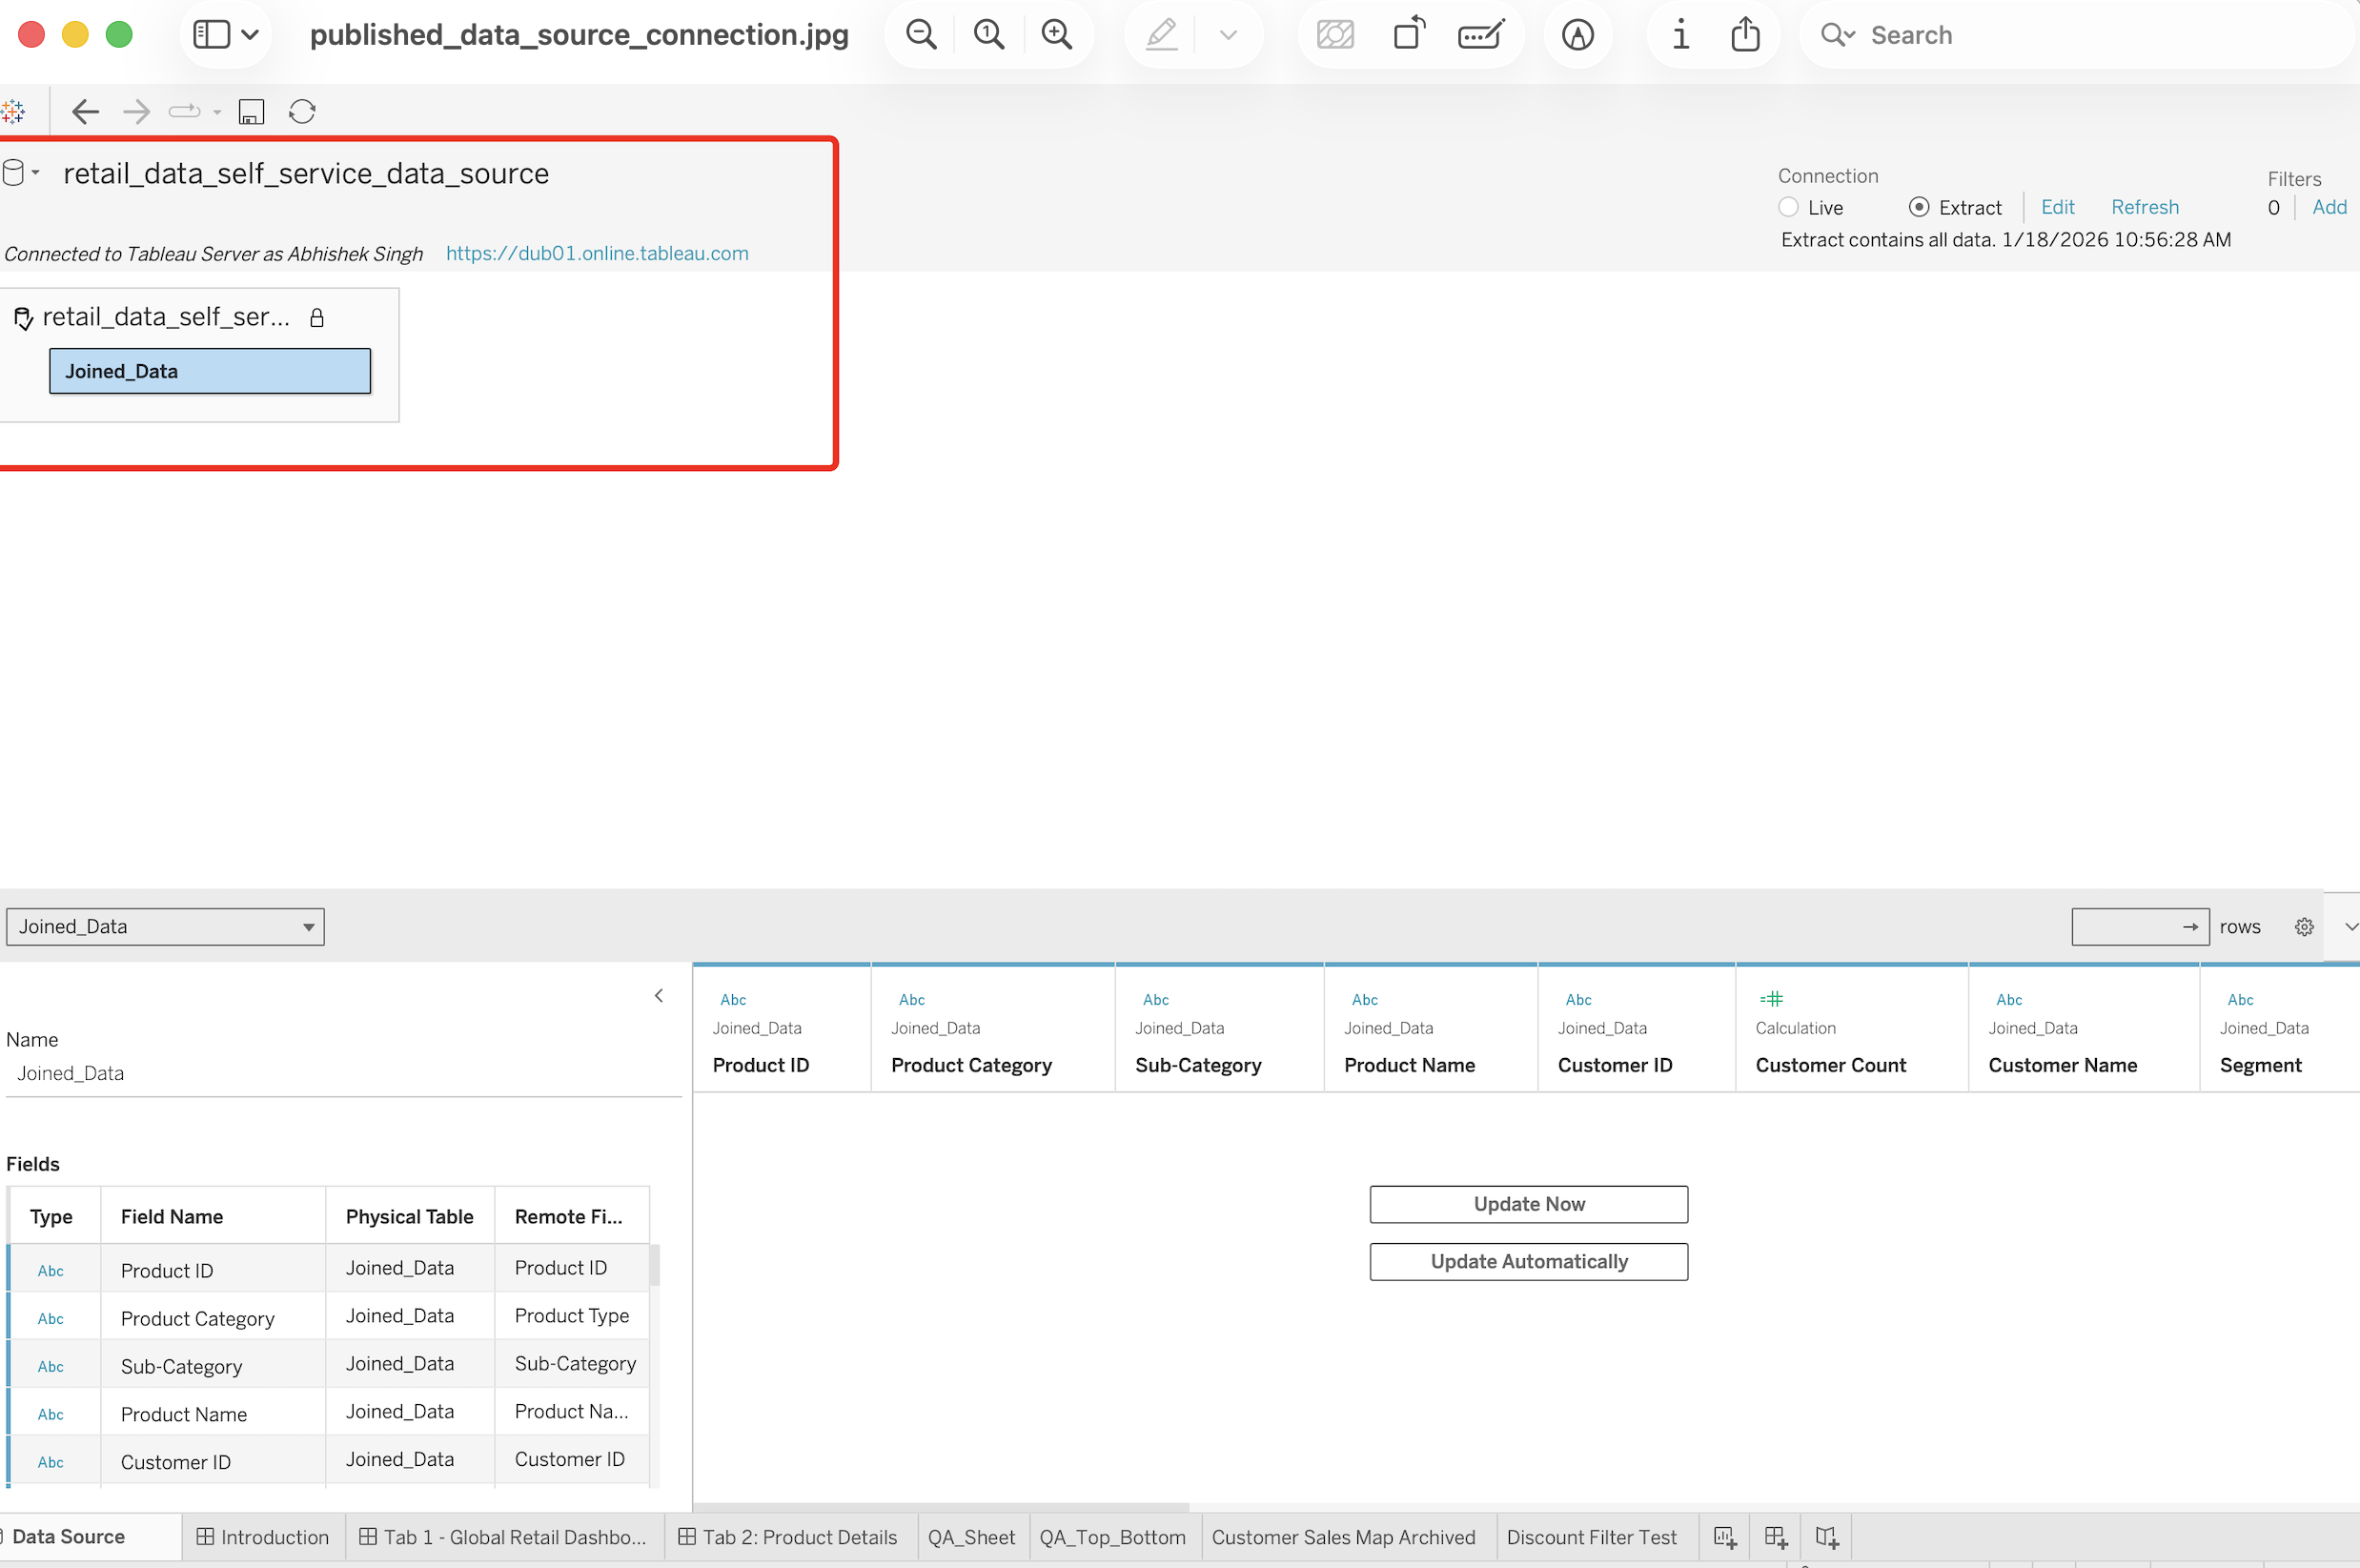
Task 2: Solution
Screenshots of dashboard tabs: Published data source of Task 1 is used to create dashboard

Slide 11
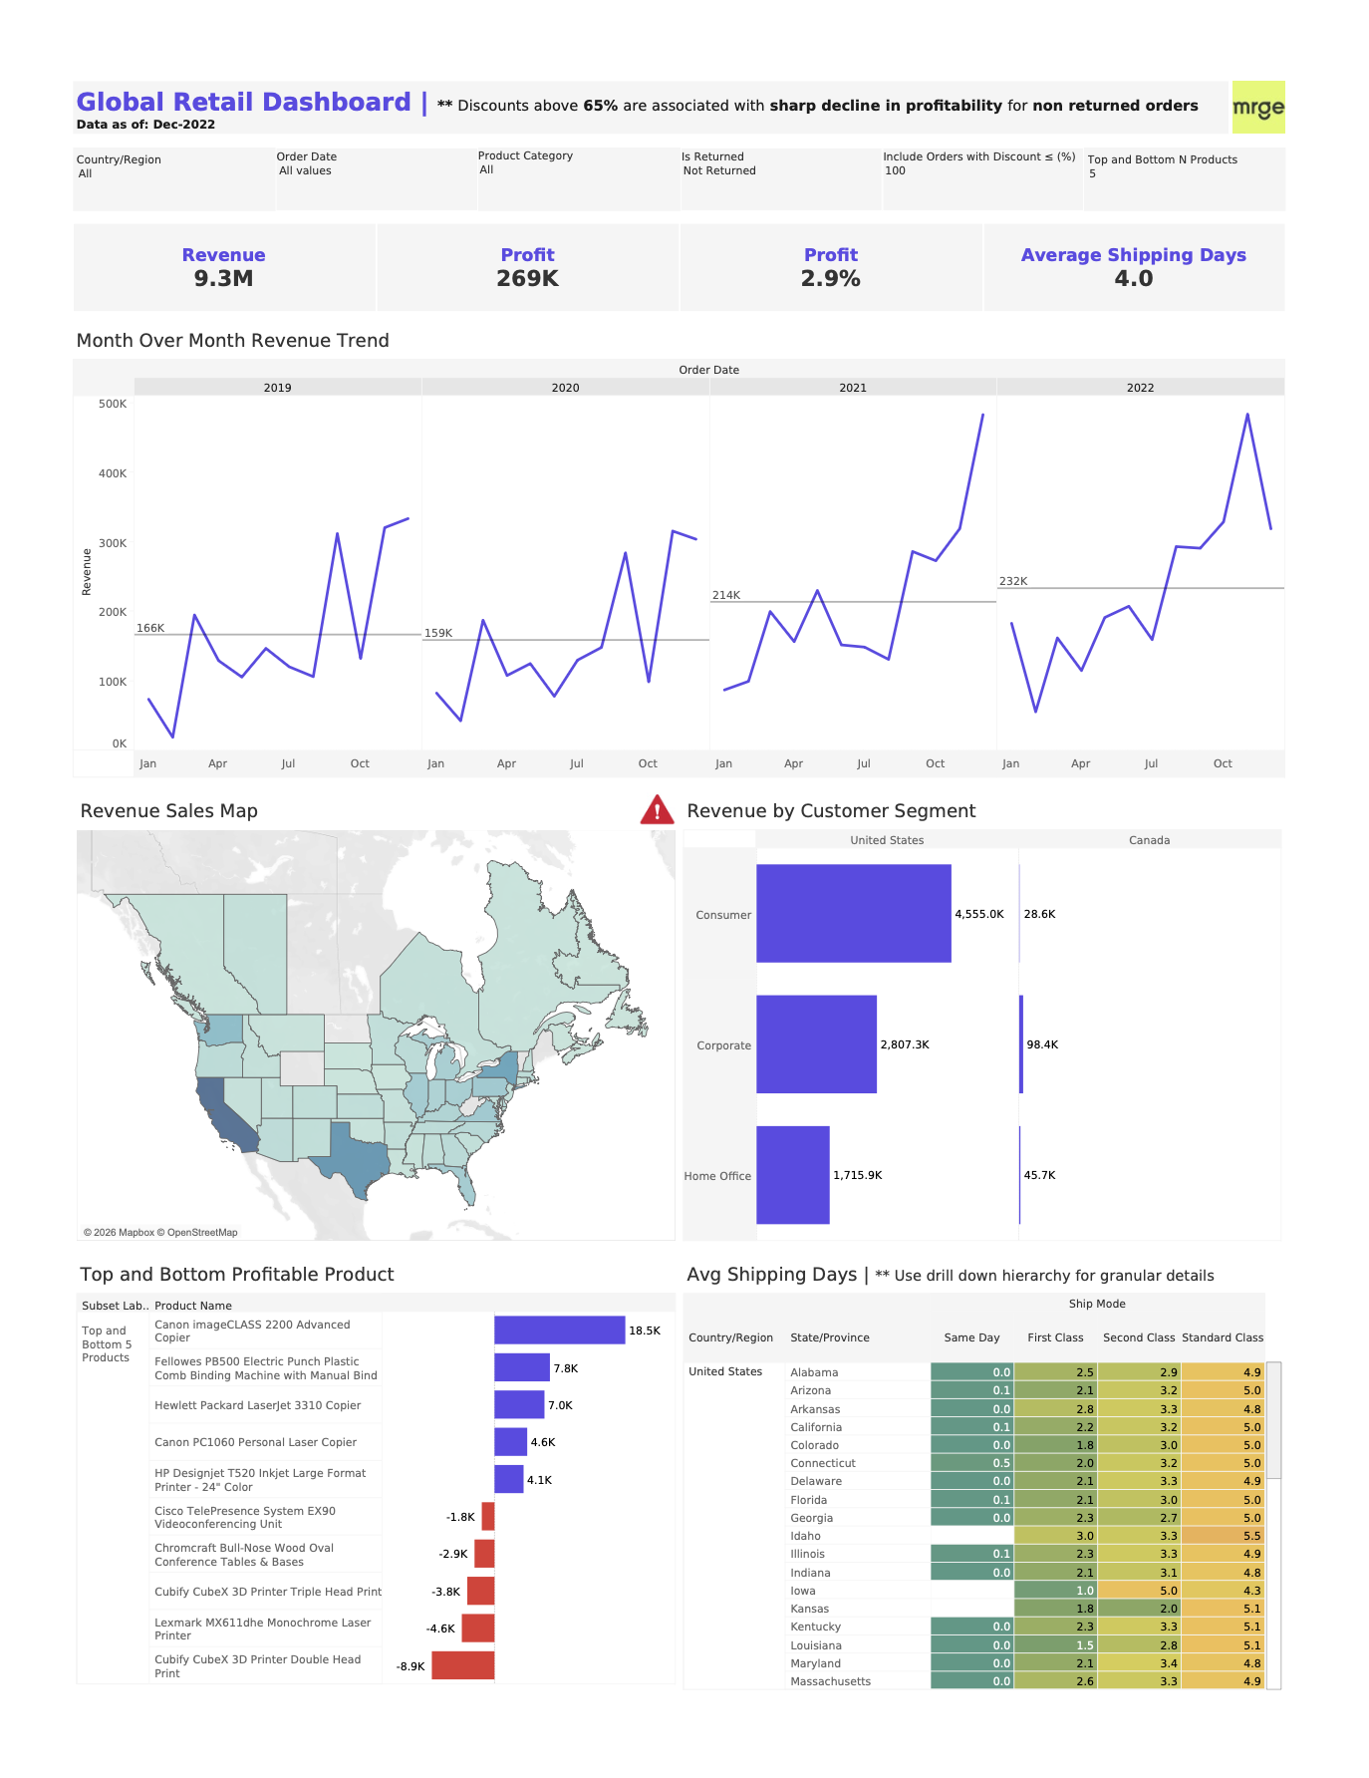
Task 2: Solution
Screenshots of dashboard tabs: Main Tab

Slide 12
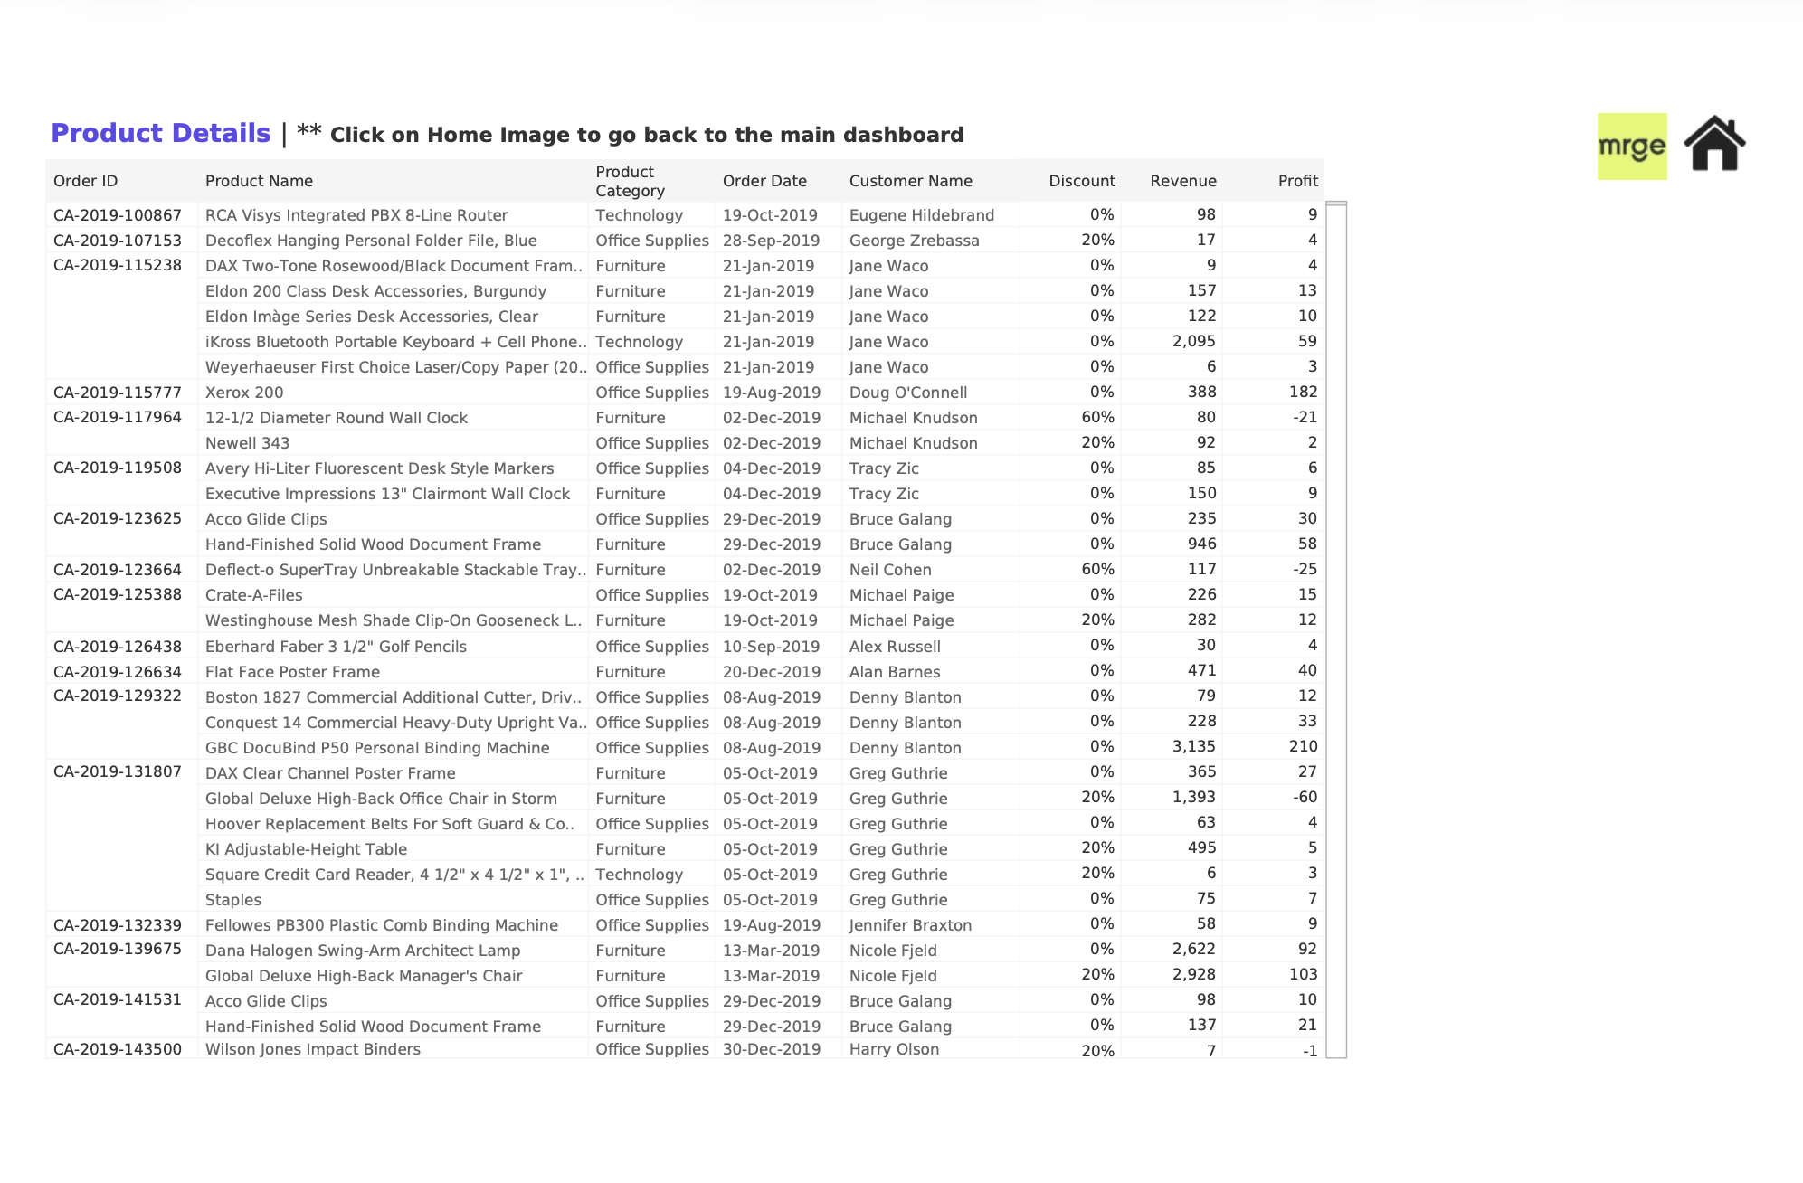
Task 2: Solution
Screenshots of dashboard tabs: Top / Bottom sheet Action filter

Slide 13
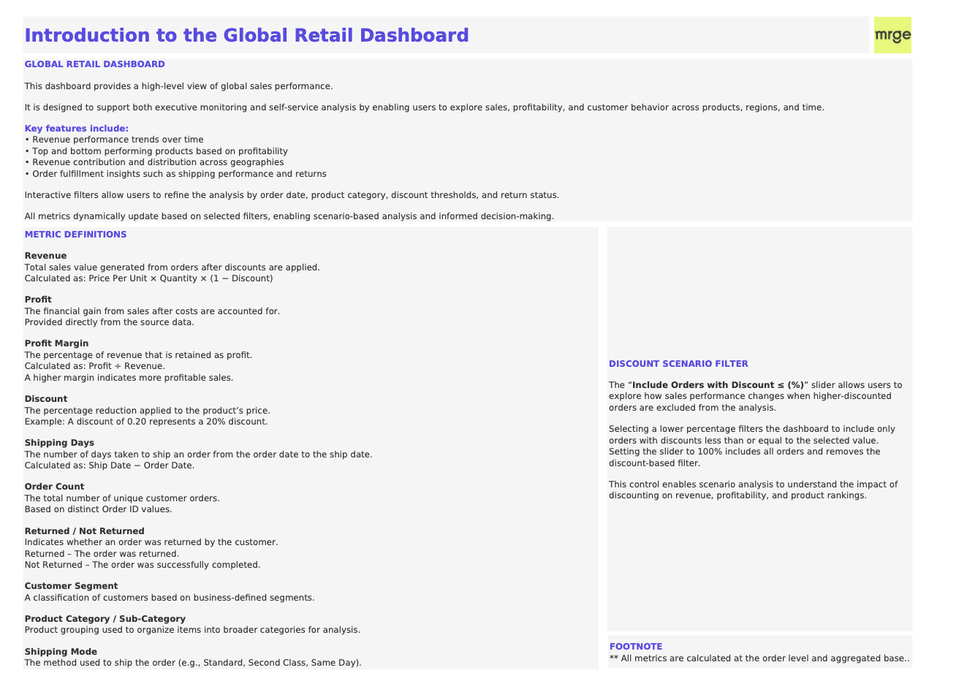
Task 2: Solution
Screenshots of dashboard tabs: Intro Tab that lists definitions and slider information!

Slide 14
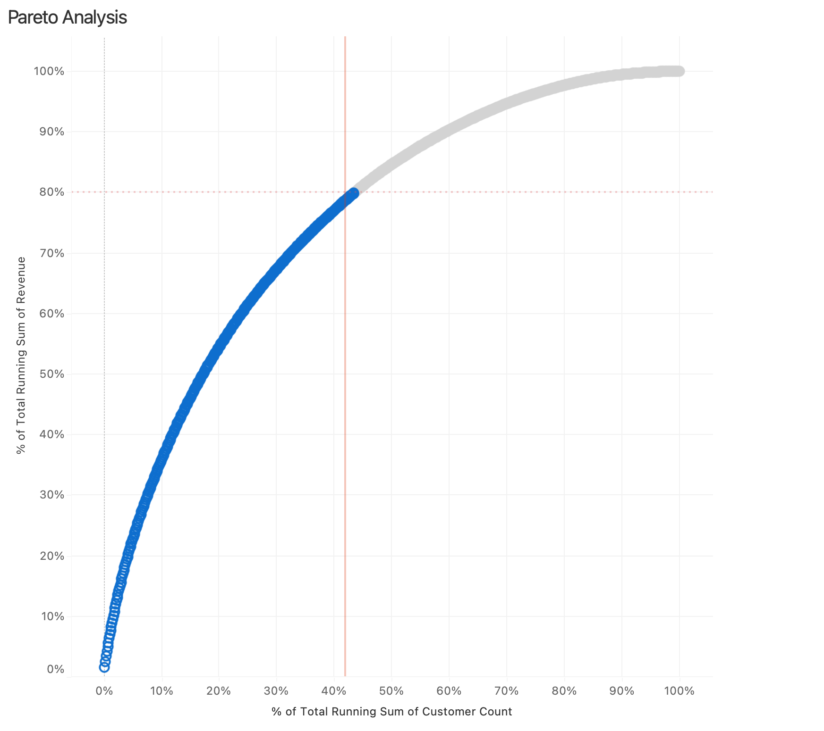
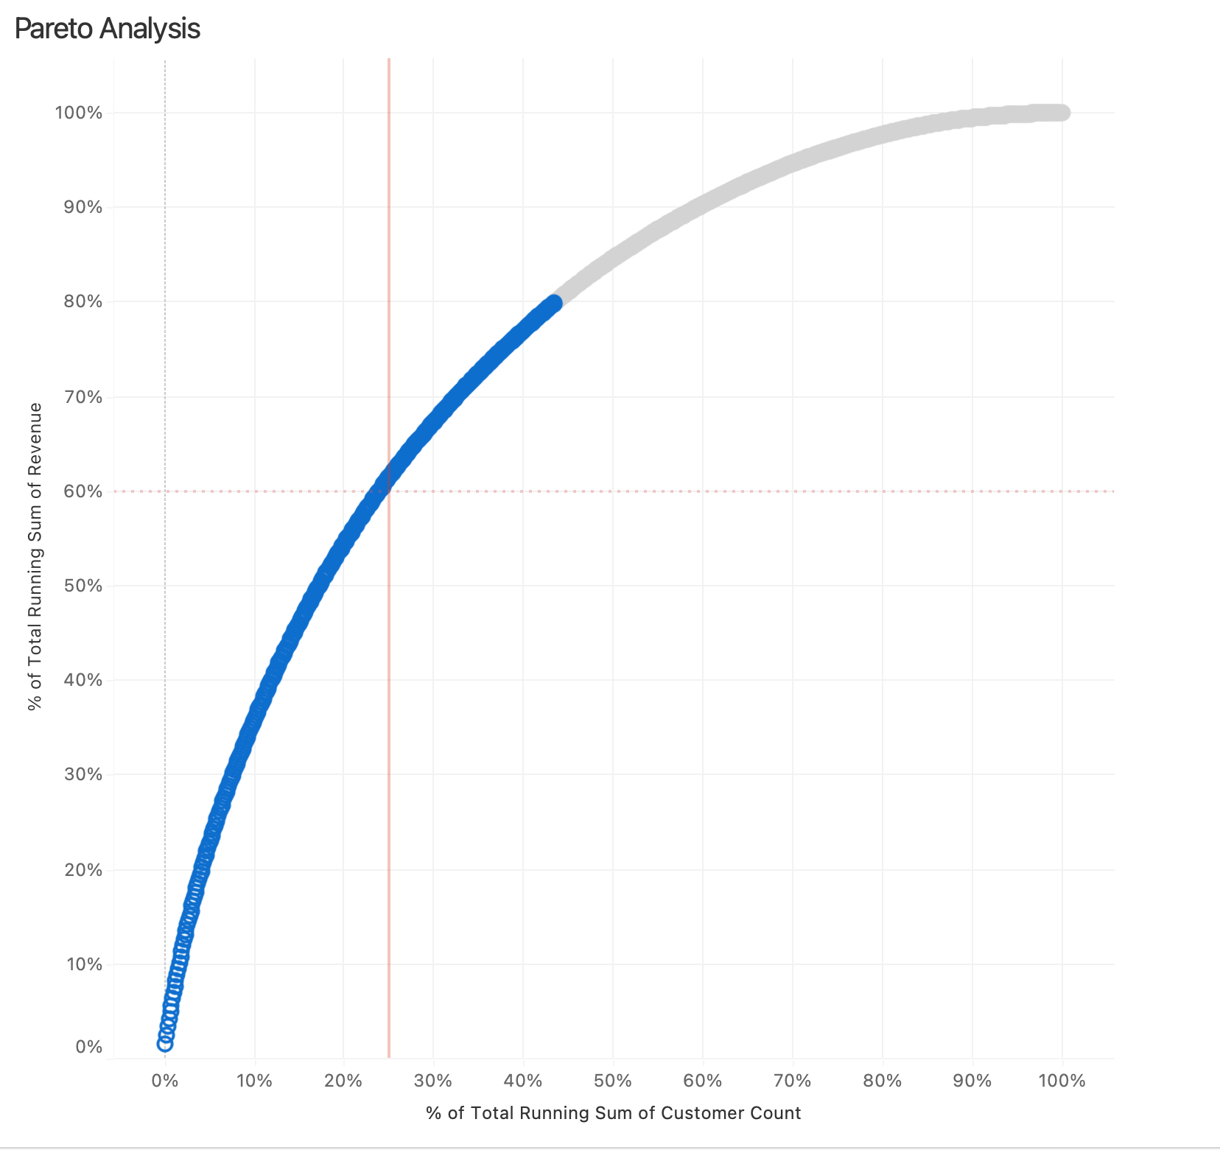
42 % Customers, 80% Revenue
Additional Insights USA:
Pareto Analysis:
• Approximately 42% of customers contribute nearly 80% of total revenue.
• Approximately 25% of customers contribute around 60% of total revenue.
This concentration highlights a core group of high-value customers who can be targeted through personalized communications, tailored promotions, or loyalty programs to maximize retention and lifetime value.
25 % Customers, 60% Revenue

Slide 15
General Insights:
Key Business Insights:
• The least profitable products are predominantly from the United States and are associated with discounts exceeding 65%, indicating that aggressive discounting is significantly eroding margins.
• Average shipping times in both the United States and Canada are approximately 4 days, suggesting an opportunity to improve fulfillment efficiency and enhance customer experience.
• Revenue is heavily concentrated across key U.S. states, with New York, California, Texas, and Washington emerging as top-performing markets.
• Consumer products represent the strongest-performing product segment in the United States, contributing the largest share of overall revenue.

Slide 16
Achtung!
The .tdsx and .twbx files should be opened using a recent, Tableau-compatible version.
In some environments, opening the data source directly from the .twbx file may result in errors. As the published data source is Excel-based, it may be unstable in certain local setups.
Older Tableau versions may not support some calculations. For example, the Profit Margin calculation uses NULLIF, which may cause errors in earlier Tableau releases.
Some images or background elements may not render correctly depending on the environment; therefore, detailed screenshots have been provided.
The Jupyter Notebook (.ipynb) should open without issues; however, an HTML version has also been included as a fallback.
Although a geographic hierarchy has been defined, Tableau does not display the drill-down (+) icon on the map in this view.

Slide 17

Thank You!

